Slide 1


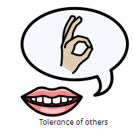



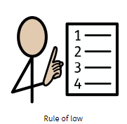

Tolerance of other cultures and religions – Inclusion (together), Involvement (teamwork)
We value the spiritual and moral development of each person as well as their intellectual and physical growth, showing courtesy and respect towards other’s beliefs, religions and cultures, accepting that we are all different
Mutual respect – Integrity (honesty), Initiative (independence), Inclusion (together)
We value the way in which all children are unique, and our curriculum promotes respect for the views of each individual child. We understand the need to treat others how we would want to be treated
Democracy - Integrity (honesty), Inspiring (believe)
We value the importance of each person in our school. We organise our curriculum so that we promote co-operation and understanding between all members of our community. We support our learning, looking after ourselves, each other and the world.
Rule of law – Integrity (honesty), Initiative (independence), Inclusion (together)
We value our environment and we aim, through our curriculum, to teach children to take responsibility for our world and how we should care for it for future generations, as well as our own.
We take responsibility for the mistakes we make, learning from them and understanding that choices have consequences for ourselves, others and/or the environment
Individual liberty –Inspiring (believe), Initiative (independence)
We value the rights enjoyed by each person in our society. We accept each child in our school for who they are, and we treat them with fairness and honesty. Our school is a safe place for children to be themselves, trusting that they are known, heard, accepted and challenged to fly

